Slide 1
Data wrangling and Feature Engineering
Lecture -9
Sumita Narang

Slide 2
Objectives
Data cleaning
Data Integration/ Aggregation
Data Sampling
Handling Numeric Data
Discretization, Binarization
Normalization
Data Smoothening
Managing Categorical Attributes
Transforming Categorical to Numerical Values
Encoding techniques
Feature Engineering
Feature Construction
Feature Extraction (Dimensionality Reduction)
Feature Subset selection
Filter methods
Wrapper methods
Embedded methods
Feature Learning
Case Study involving FE tasks
Dealing with textual Data

Slide 3
Feature Engineering
Source Courtesy: Some of the contents of this PPT are sourced from materials provided by publishers of prescribed books

Slide 4
Feature Engineering
Motivation for feature engineering
Define Feature and Feature engineering
Machine learning workflow

Slide 5
Motivation for Feature Engineering - Case study - 1
Real Estate price prediction
Problem Definition: Given the characteristics in terms of landmark, facilities, complaints etc. of property predict the sale price.
Data Set Description: The dataset has 108 Features and 6664 instances. The dependent variable is the sale price.
Name of the person
Address
Pincode
Area_code
Building_Area
Common_Area
Type_of_Flooring
School_Nearby

Slide 6
Motivation for Feature Engineering – Case Study - 2
Problem Definition: Given a data set of customer purchasing data gathered over a year, predict which customers will return to make a purchase.
Data set: The set contains around 350 million rows and 11 features has the following features:
Customer ID
Store ID
Department ID
Product Category
Manufacturer
Brand of the product
Date of Purchase
Product Size
Product Measure
Purchase quantity
Product price
Has bought from manufacturer X

Slide 7
Motivation for Feature Engineering – Case Study - 3
Problem Definition: Given a data set of cancer patients and the tests they have undergone to predict whether a patient will have cancer or not.
Data set: The set contains around 100 million rows and 35 features has the following features:
Patient id
Name
Age
Gender
Profession
Martial status
Biopsy
Endoscopy
Diagnostic Imaging
Blood Tests
Patient id
Age
Gender
Biopsy
Blood Tests
Endoscopy
Feature Selection

Slide 8
Feature
Feature is a property of an object under study.
Features are the basic building blocks of datasets.
Building Area | Common Area | Type of Flooring | DistanceFrom BusDepot | Sale Price per square feet
11345 | 350 | Marble | 16503.22 | 6,715
2000 | 1334 | Vitrified Tiles | 16321.19 | 3,230
2544 | 924 | Wood Vitrified Tiles | 15619.92 | 6,588

Slide 9
Feature Engineering
Feature Engineering is the process of selecting and extracting useful, predictive signals from data.
The goal is to create a set of features that best represent the information contained in the data, producing a simpler model that generalizes well to future observations.
Steps to do feature engineering are as follows:
Brainstorm features.
Create features.
Check how the features work with the model.
Start again from first until the features work perfectly.
Feature engineering is the process of transforming raw data into features that better represent the underlying problem to the predictive models, resulting in improved model accuracy on unseen data.
Feature engineering turn your inputs into things the algorithm can understand.

Slide 10

Machine Learning Workflow
Feature Engineering - process
Target/Class Label
Data Integration
Tree Based Model
Data quality &
Transformation
Model Building
Regression Model
Features/Attributes
Multiple data sources
Feature Engineering
Feature Creation
Feature Reduction
Feature Selection
Mapping Data to new space
Feature extraction (splitting etc.)
New Feature Construction

Slide 11
Feature Creation/ Construction
Define Feature creation.
List the commonly used methodologies for Feature Creation.
Identify appropriate techniques to be used given a data set.

Slide 12
Feature Construction
Create new attributes that can capture important information in a data set much more efficiently than the original attributes.
Three general methodologies:
Mapping Data to New Space
Feature Construction
Feature Extraction
Feature Engineering
Feature Creation/ Construction
Feature Selection
Mapping Data to new space
New Feature Construction
Feature Extraction
Dimensionality Reduction
E.g. Categorical to numerical
Create Derived Features

Slide 13
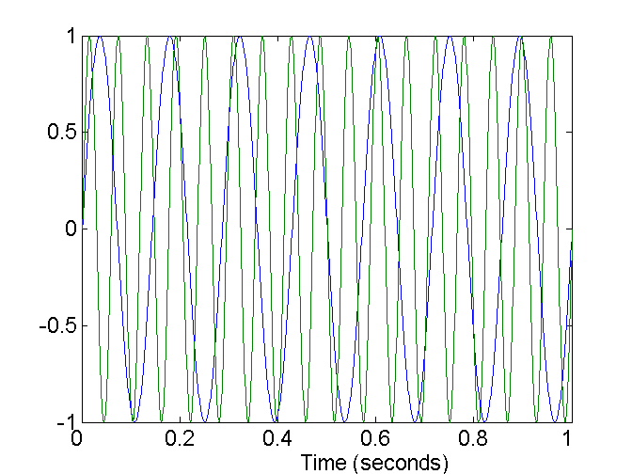
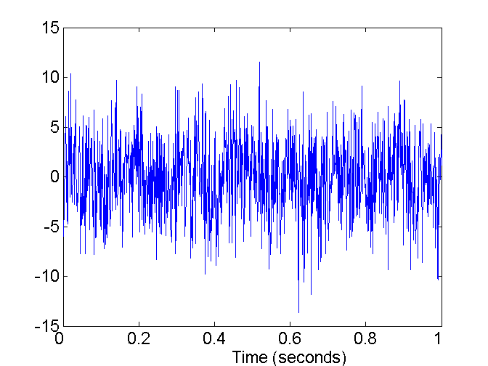
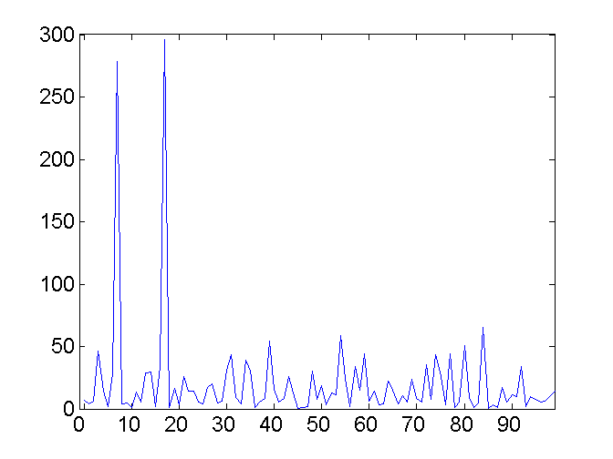

Mapping Data to a New Space
Fourier transform
Wavelet transform
Scale-Invariant Feature Transform (SIFT)
Two Sine Waves
Two Sine Waves + Noise
Frequency

Slide 14
Mapping Data to a New Space
Fourier transform
Wavelet transform
Two Sine Waves
Two Sine Waves + Noise
Frequency
Notes:
14

Slide 15
Wavelet Transformation
Discrete wavelet transform (DWT) for linear signal processing, multi-resolution analysis
Compressed approximation: store only a small fraction of the strongest of the wavelet coefficients
Similar to discrete Fourier transform (DFT), but better lossy compression, localized in space
Method:
Length, L, must be an integer power of 2 (padding with 0’s, when necessary)
Each transform has 2 functions: smoothing, difference
Applies to pairs of data, resulting in two set of data of length L/2
Applies two functions recursively, until reaches the desired length
Notes:
15

Slide 16
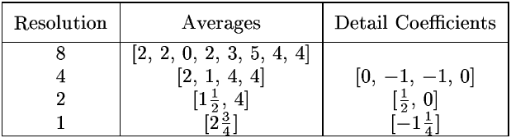
Wavelet Decomposition
Wavelets: A math tool for space-efficient hierarchical decomposition of functions
S = [2, 2, 0, 2, 3, 5, 4, 4] can be transformed to S^ = [2³/₄, -1¹/₄, ¹/₂, 0, 0, -1, -1, 0]
Compression: many small detail coefficients can be replaced by 0’s, and only the significant coefficients are retained
Notes:
16

Slide 17
Feature construction
Create dummy features: Often used to convert categorical variable into numerical variables.
Customer_ID | Gender | Paymet_Method | Online Banking | Credit Card | Debit Card
C001 | FEMALE | Online Banking | 1 | 0 | 0
C002 | MALE | Online Banking | 1 | 0 | 0
C003 | FEMALE | Credit Card | 0 | 1 | 0
C004 | MALE | Debit Card | 0 | 0 | 1
Notes:
Used when the modeling algorithm that does not accept categorical features. for example Neural network

Slide 18
Feature construction
Create derived features
Customer_ID | Gender | Session_Begin | Session_End | Session_Duration
C001 | FEMALE | 15-06-2019 10.30 | 15-06-2019 11.15 | 45
C002 | MALE | 13-06-2019 8.00 | 13-06-2019 8.03 | 3
C003 | FEMALE | 2-06-2019 16.25 | 2-06-2019 18.35 | 126
C004 | MALE | 1-06-2019 11.20 | 1-06-2019 1.00 | 100

Slide 19
Derived features examples
Commonly used tricks
Handling date, time and addresses
Handling sales and Marketing data
Handling large range of values using standard transformations
Encoding special objects as influencing person
Notes:
https://www.analyticsvidhya.com/blog/2013/11/simple-manipulations-extract-data/

Slide 20
Feature/Attribute Creation
(Feature Generation)
Create new attributes (features) that can capture the important information in a data set more effectively than the original ones
Three general methodologies
Mapping data to new space (see: data reduction)
E.g., Fourier transformation, wavelet transformation
Attribute construction
Combining features
Data discretization
Attribute extraction
Domain-specific
Feature Engineering
Feature Creation/ Construction
Feature Selection
Mapping Data to new space
New Feature Construction
Feature Extraction
Dimensionality Reduction
E.g. Categorical to numerical
Create Derived Features
20
Notes:
20

Slide 21
Data Reduction – Feature Extraction
Data reduction: Obtain a reduced representation of the data set that is much smaller in volume but yet produces the same (or almost the same) analytical results
Why data reduction? — A database/data warehouse may store terabytes of data. Complex data analysis may take a very long time to run on the complete data set.
Data reduction strategies
Dimensionality reduction, e.g., remove unimportant attributes
Wavelet transforms
Principal Components Analysis (PCA)
Feature subset selection, feature creation
Numerosity reduction (some simply call it: Data Reduction)
Regression and Log-Linear Models
Histograms, clustering, sampling
Data cube aggregation
Data compression
Notes:
MK 09/09/05: Wiki has dimensionality reduction as feature extraction (PCA) and feature subset selection. It states both wavelet transforms and PCA as forms of data compression. It does not have any pages for "numerosity reduction". We claim there are many different ways to organize data reduction strategies, which is true, so this presentation below should be OK. Let’s discuss.

Slide 22
Data Reduction: Numerosity Reduction
Reduce data volume by choosing alternative, smaller forms of data representation
Parametric methods (e.g., regression)
Assume the data fits some model, estimate model parameters, store only the parameters, and discard the data (except possible outliers)
Ex.: Log-linear models—obtain value at a point in m-D space as the product on appropriate marginal subspaces
Non-parametric methods
Do not assume models
Major families: histograms, clustering, sampling, …

Slide 23
Data Reduction : Dimensionality Reduction
Curse of dimensionality
When dimensionality increases, data becomes increasingly sparse
Density and distance between points, which is critical to clustering, outlier analysis, becomes less meaningful
The possible combinations of subspaces will grow exponentially
Dimensionality reduction
Avoid the curse of dimensionality
Help eliminate irrelevant features and reduce noise
Reduce time and space required in data mining
Allow easier visualization
Dimensionality reduction techniques
Wavelet transforms
Principal Component Analysis
Supervised and nonlinear techniques (e.g., feature selection)
Notes:
23
JH: put SVD at clustering high-D reduction.

Slide 24
Dimension Reduction Approaches
Feature Reduction via Domain Knowledge
Speech waveform -> FCC data samples
Vision -> pixels to high level features in image
Mathematical approaches
Feature Reduction via Feature Selection (5 columns; remove 3 columns select only 2 columns – based on mathematical approaches lets say Info Gain
Feature Reduction via Feature Extraction (5 columns; try to extract information and depict that information in some way as 2 columns -> project on a 2D plane)

Slide 25
Dimensionality Reduction – Spectral Dimension Reduction (Eigen Vector and Eigen Values)
https://www.youtube.com/watch?v=ue3yoeZvt8E
A . V = λ . V
If a matrix satisfies the above equation; here
V = Eigen Vector
Λ = Eigen Value
This implies that there are certain points (& their connecting vector) in the spacial domain, which when applied any kind of transformation; only stretch but do not change direction.
Dimensionality Reduction Algorithms
Large number of algorithms; all have these steps –
Find a similarity matrix for your R matrix (how you compute this, varies for different algorithms)
Find the Eigen Vectors of the Similarity Matrix
Note- Eigen Vectors would be the Reduced dimensional vector for your original Matrix on which you can apply your Data Modelling algorithms

Slide 26
PCA (Principal Component Analysis) – Dimensionality Reduction
https://www.youtube.com/watch?v=g-Hb26agBFg
PCA -> projecting the points in a multi dimensional space on two linear vectors; so that the points are distinctly spaced. (Taking picture of points from two angles such that we get maximum coverage).
- In other words; you try to find the co-relation between various features(columns) and then try to project them on a 2D Plane (https://www.youtube.com/watch?v=HMOI_lkzW08)
Discuss in class -
Mean, Variance, Covariance
Steps in PCA -
- Find the Covariance Matrix
Find Eigen Vectors and Eigen Values of Covariance Matrix
Select top two Eigen Vectors (PC1 and PC2)’ which project these points on a 2D plane

Slide 27
Principal Component Analysis (PCA)
Find a projection that captures the largest amount of variation in data
The original data are projected onto a much smaller space, resulting in dimensionality reduction.
x₂
e
x₁

Slide 28
Principal Component Analysis (Steps)
Given N data vectors from n-dimensions, find k ≤ n orthogonal vectors (principal components) that can be best used to represent data
Normalize input data: Each attribute falls within the same range
Compute k orthonormal (unit) vectors, i.e., principal components
Each input data (vector) is a linear combination of the k principal component vectors
The principal components are sorted in order of decreasing “significance” or strength
Since the components are sorted, the size of the data can be reduced by eliminating the weak components, i.e., those with low variance (i.e., using the strongest principal components, it is possible to reconstruct a good approximation of the original data)
Works for numeric data only

Slide 29
Feature Selection –
Attribute Subset Selection
Another way to reduce dimensionality of data
Redundant attributes
Duplicate much or all of the information contained in one or more other attributes
E.g., purchase price of a product and the amount of sales tax paid
Irrelevant attributes
Contain no information that is useful for the data mining task at hand
E.g., students' ID is often irrelevant to the task of predicting students' GPA

Slide 30
Feature Selection Methods
Filter methods
Wrapper methods
Embedded methods
References
https://www.analyticsvidhya.com/blog/2016/12/introduction-to-feature-selection-methods-with-an-example-or-how-to-select-the-right-variables/#:~:text=Filter%20methods%20are%20generally%20used,is%20a%20subjective%20term%20here.
https://towardsdatascience.com/feature-selection-in-python-using-filter-method-7ae5cbc4ee05
https://heartbeat.fritz.ai/hands-on-with-feature-selection-techniques-filter-methods-f248e0436ce5

Slide 31
Feature Selection Methods
- Filter Method Types
Features are selected on the basis of their scores in various statistical tests for their correlation with the outcome variable.
There are two types of Filter methods : Univariate and Multivariate.
Univariate filter methods evaluate and rank a single feature according to certain criteria.
They treat each feature individually and independently of the feature space. This is how it functions in practice:
It ranks features according to certain criteria.
Then select the highest ranking features according to those criteria.
One problem that can occur with univariate methods is they may select a redundant variable, as they don’t take into consideration the relationship between features.
Multivariate filter methods, on the other hand, evaluate the entire feature space. They take into account features in relation to other ones in the dataset.
These methods are able to handle duplicated, redundant, and correlated features.

Slide 32
Filter Method – Adv. and Disadv.
Advantages of Filter methods
Filter methods are model agnostic
Rely entirely on features in the data set
Computationally very fast
Based on different statistical methods
The disadvantage of Filter methods
The filter method looks at individual features for identifying it’s relative importance. A feature may not be useful on its own but maybe an important influencer when combined with other features. Filter methods may miss such features.
Filter criteria for selecting the best feature
Select independent features with
High correlation with the target variable
Low correlation with another independent variable
Higher information gain or mutual information of the independent variable

Slide 33
Filter Methods 1/
Methods-
Basic Filter Methods
Correlation Filter Methods
Statistical & Ranking Filter Methods
The filter method ranks each feature based on some uni-variate metric and then selects the highest-ranking features. Some of the uni-variate metrics are -
variance: removing constant and quasi constant features
chi-square: used for classification. It is a statistical test of independence to determine the dependency of two variables.
correlation coefficients: removes duplicate features
Information gain or mutual information: assess the dependency of the independent variable in predicting the target variable. In other words, it determines the ability of the independent feature to predict the target variable

Slide 34
Filter Methods
Basic Filter Methods
Constant Features
Quasi-Constant Features
Correlation Filter Methods
Pearson correlation coefficient
Statistical & Ranking Filter Methods
Duplicated Features
Spearman’s rank correlation coefficient
Kendall’s rank correlation coefficient
Mutual Information
Chi-squared Score
ANOVA Univariate Test
Univariate ROC-AUC /RMSE

Slide 35
Basic Filter Methods
Constant Features that show single values in all the observations in the dataset. These features provide no information that allows ML models to predict the target.
Quasi-Constant Features in which a value occupies the majority of the records.
Duplicated Features, which is self-explanatory—the same feature.

Slide 36
Correlation Filter Methods 1/
Besides duplicate features, a dataset can also include correlated features.
Correlation is defined as a measure of the linear relationship between two quantitative variables, like height and weight. You could also define correlation is a measure of how strongly one variable depends on another.
A high correlation is often a useful property—if two variables are highly correlated, we can predict one from the other. Therefore, we generally look for features that are highly correlated with the target, especially for linear machine learning models.
However, if two variables are highly correlated among themselves, they provide redundant information in regards to the target. Essentially, we can make an accurate prediction on the target with just one of the redundant variables. In these cases, the second variable doesn’t add additional information, so removing it can help to reduce the dimensionality and also the added noise.

Slide 37
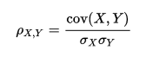
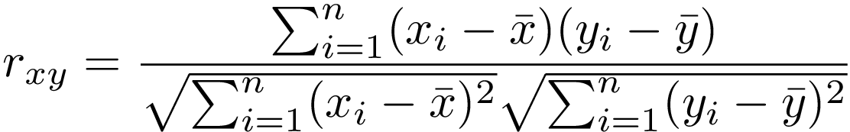
Correlation Filter Methods 2/
Pearson correlation coefficient
It’s used to summarize the strength of the linear relationship between two data variables, which can vary between 1 and -1:
1 means a positive correlation: the values of one variable increase as the values of another increase.
-1 means a negative correlation: the values of one variable decrease as the values of another increase.
0 means no linear correlation between the two variables.
The assumptions that the Pearson correlation coefficient makes:
Both variables should be normally distributed.
A straight-line relationship between the two variables.
Data is equally distributed around the regression line.

Slide 38
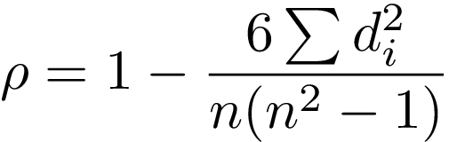
Correlation Filter Methods 3/
Spearman’s rank correlation coefficient
Sometimes two variables can be related in a nonlinear relationship, which can be stronger or weaker across the distribution of the variables.
And this is where Spearman’s rank correlation coefficient comes into play. It’s a non-parametric test that’s used to measure the degree of association between two variables with a monotonic function, meaning an increasing or decreasing relationship.
The measured strength between the variables using Spearman’s correlation varies between+1 and −1, which occurs when each of the variables is a perfect monotone function of the other. It's a lot like Pearson’s correlation, but whereas Pearson’s correlation assesses linear relationships, Spearman’s correlation assesses monotonic relationships (whether linear or not).
Spearman’s coefficient is suitable for both continuous and discrete ordinal variables.
The Spearman’s rank correlation test doesn’t carry any assumptions about the distribution of the data.

Slide 39
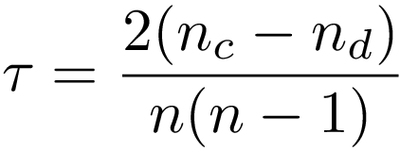
Correlation Filter Methods 4/
Kendall’s rank correlation coefficient
Kendall’s rank correlation coefficient is a non-parametric test that measures the strength of the ordinal association between two variables. It calculates a normalized score for the number of matching or concordant rankings between the two data samples.
Kendall’s correlation varies between 1 and -1. It will take the value of 1 (high) when observations have a similar rank between the two variables, and value of -1 (low) when observations have a dissimilar rank between the two variables.
This type of correlation is best suited for discrete data. The following formula is used to calculate the value of Kendall’s rank correlation:

Slide 40
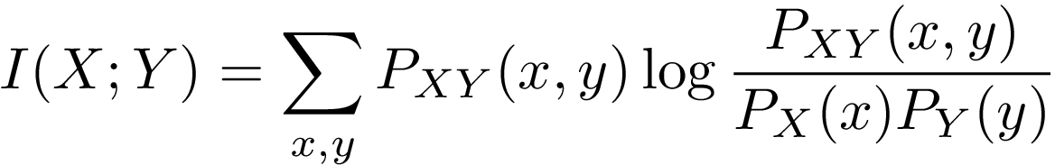
Statistical and Ranking Filter Methods 1/
These methods are statistical tests that evaluate each feature individually. By shedding light on the target, they evaluate whether the variable is important in order to discriminate against the target.
Essentially, these methods rank the features based on certain criteria or metrics and then select the features with the highest ranking.
Mutual Information
Mutual information a measure of the mutual dependence of two variables. It measures the amount of information obtained about one variable through observing the other variable. In other words, it determines how much we can know about one variable by understanding another—it’s a little bit like correlation, but mutual information is more general.
In machine learning, mutual information measures how much information the presence/absence of a feature contributes to making the correct prediction on Y.
If X and Y are independent, their MI is Zero. If X is deterministic of Y, then MI is the entropy of X, which is a notion in information theory that measures or quantifies the amount of information within a variable.

Slide 41
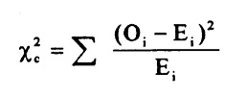
Statistical and Ranking Filter Methods 2/
The subscript “c” are the degrees of freedom. “O” is your observed value and E is your expected value.
Chi-squared Score
This is another statistical method that’s commonly used for testing relationships between categorical variables. Therefore, it’s suited for categorical variables and binary targets only, and the variables should be non-negative and typically boolean, frequencies, or counts.
What it does is simply compare the observed distribution between various features in the dataset and the target variable.
A chi-square test for independence compares two variables in a contingency table to see if they are related. In a more general sense, it tests to see whether distributions of categorical variables differ from each another.
A very small chi square test statistic means that your observed data fits your expected data extremely well. In other words, there is a relationship.
A very large chi square test statistic means that the data does not fit very well. In other words, there isn’t a relationship.

Slide 42
Statistical and Ranking Filter Methods 3/
ANOVA Univariate Test
A univariate test, or more specifically ANOVA ( — short for ANalysis Of VAriance), is similar to the previous scores, as it measures the dependence of two variables.
ANOVA assumes a linear relationship between the variables and the target, and also that the variables are normally distributed.
It’s well-suited for continuous variables and requires a binary target, but sklearn extends it to regression problems, also.
Univariate ROC-AUC /RMSE
This method uses machine learning models to measure the dependence of two variables. It’s suitable for all variables, and also makes no assumptions about their distribution.
The measure here depends on the problem: we use RMSE for regression problems and ROC-AUC for classification problems.
The procedure is as follows:
Build a decision tree using a single variable and target.
Rank features according to the model RMSE or ROC-AUC
Select the features with higher ranking scores.

Slide 43
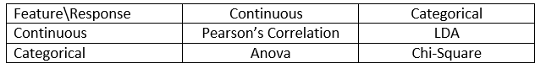
Filter Method – Relation with Target
Pearson’s Correlation: It is used as a measure for quantifying linear dependence between two continuous variables X and Y. Its value varies from -1 to +1. Pearson’s correlation is given as:
LDA: Linear discriminant analysis is used to find a linear combination of features that characterizes or separates two or more classes (or levels) of a categorical variable.
ANOVA: ANOVA stands for Analysis of variance. It is similar to LDA except for the fact that it is operated using one or more categorical independent features and one continuous dependent feature. It provides a statistical test of whether the means of several groups are equal or not.
Chi-Square: It is a is a statistical test applied to the groups of categorical features to evaluate the likelihood of correlation or association between them using their frequency distribution.

Slide 44
How to find most impacting features – Feature Selection?
https://towardsdatascience.com/feature-selection-techniques-in-machine-learning-with-python-f24e7da3f36e
Filter Method Approaches:
3 Feature selection techniques that are easy to use and also gives good results.
Univariate Selection
Feature Importance
Correlation Matrix with Heatmap

Slide 45
1. Univariate Feature Selection
https://blog.datadive.net/selecting-good-features-part-i-univariate-selection/
Univariate feature selection examines each feature individually to determine the strength of the relationship of the feature with the response variable. These methods are simple to run and understand and are in general particularly good for gaining a better understanding of data (but not necessarily for optimizing the feature set for better generalization).
Note- Univariate feature selection is in general best to get a better understanding of the data, its structure and characteristics. It can work for selecting top features for model improvement in some settings, but since it is unable to remove redundancy (for example selecting only the best feature among a subset of strongly correlated features), this task is better left for other methods.
There are lot of different options for univariate selection. Statistical tests can be used to select those features that have the strongest relationship with the output variable.
1. Pearson Correlation
2. Mutual information and maximal information coefficient (MIC)
3. Distance correlation
4. Model based ranking

Slide 46
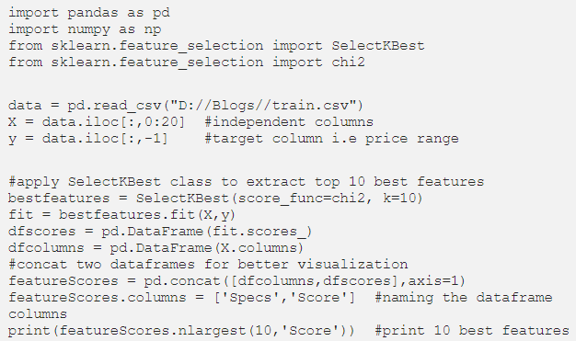
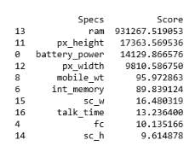
1. Univariate Feature Selection
For example, use the chi-squared (chi²) statistical test for non-negative features to select 10 of the best features from Prediction Dataset

Slide 47
2. Feature Importance
Feature importance gives you a score for each feature of your data, the higher the score more important or relevant is the feature towards your output variable.
Feature importance is an inbuilt class that comes with Tree Based Classifiers, we will be using Extra Tree Classifier for extracting the top 10 features for the dataset.

Slide 48
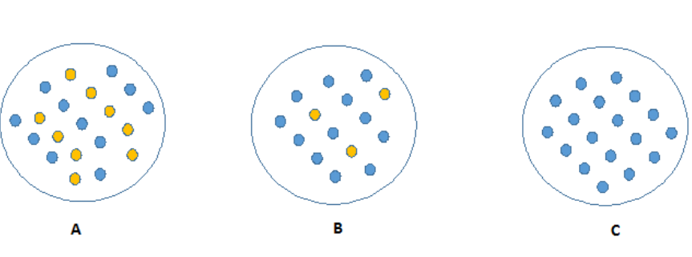
How to select the deciding node?
Given 15 independent variables(attributes impacting DV) in above example, we need to predict Wealth (DV), how do we start with root node (starting most affecting attribute), and select subsequent nodes.
Which is the best Classifier?
Which node can be described easily?

Slide 49
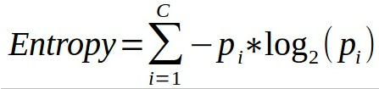
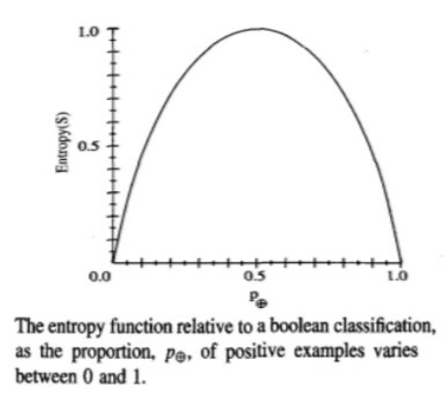
Information Theory - Entropy
Information theory is a measure to define this degree of disorganization in a system known as Entropy.
Entropy – measuring homogeneity of a learning set
Given a collection S, containing positive and negative examples of some target concept, the entropy of S relative to this classification.
where, pi is the proportion of S belonging to class i
Entropy is 0 if all the members of S belong to the same class.
Entropy is 1 when the collection contains an equal no. of +ve and -ve examples.
Entropy is between 0 and 1 if the collection contains unequal no. of +ve and -ve examples.

Slide 50
Entropy - Example

Slide 51
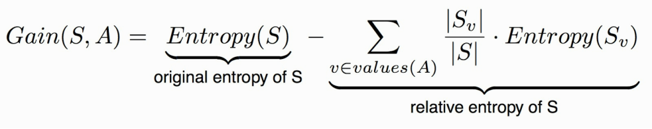
Information Gain
Decides which attribute goes into a decision node.
To minimize the decision tree depth, the attribute with the most entropy reduction is the best choice!
The information gain, Gain(S,A) of an attribute A,
Where –
S is each value v of all possible values of attribute A
Sv = subset of S for which attribute A has value v
|Sv| = number of elements in Sv
|S| = number of elements in S

Slide 52
Information Gain - Example

Slide 53
Problems with information gain
Natural bias of information gain: it favours attributes with many possible values.
Consider the attribute Date in the PlayTennis example.
Date would have the highest information gain since it perfectly separates the training data.
It would be selected at the root resulting in a very broad tree
Very good on the training, this tree would perform poorly in predicting unknown instances. Overfitting.
The problem is that the partition is too specific, too many small classes are generated.
We need to look at alternative measures …

Slide 54
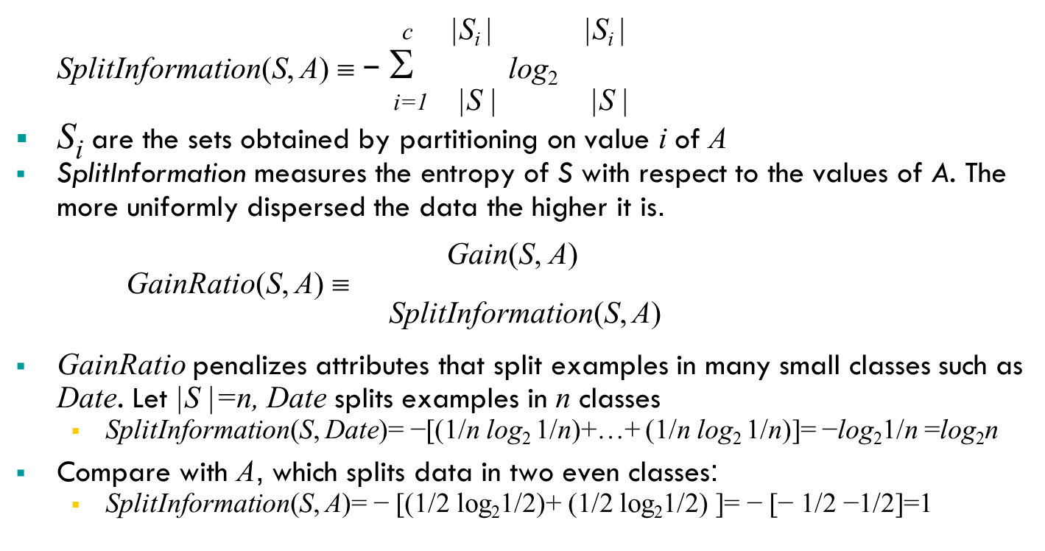
An alternative measure: gain ratio
Notes:
2^{-x} = 1/2^{x}

Slide 55
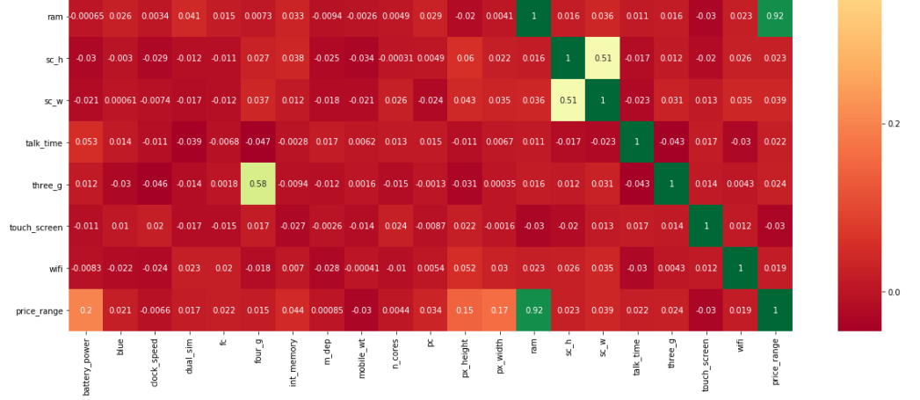
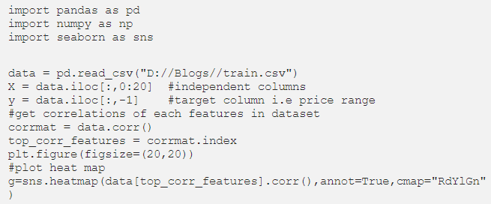
3. Correlation Matrix with Heatmap
Correlation states how the features are related to each other or the target variable.
Correlation can be positive (increase in one value of feature increases the value of the target variable) or negative (increase in one value of feature decreases the value of the target variable)
Heatmap makes it easy to identify which features are most related to the target variable, we will plot heatmap of correlated features using the seaborn library.

Slide 56
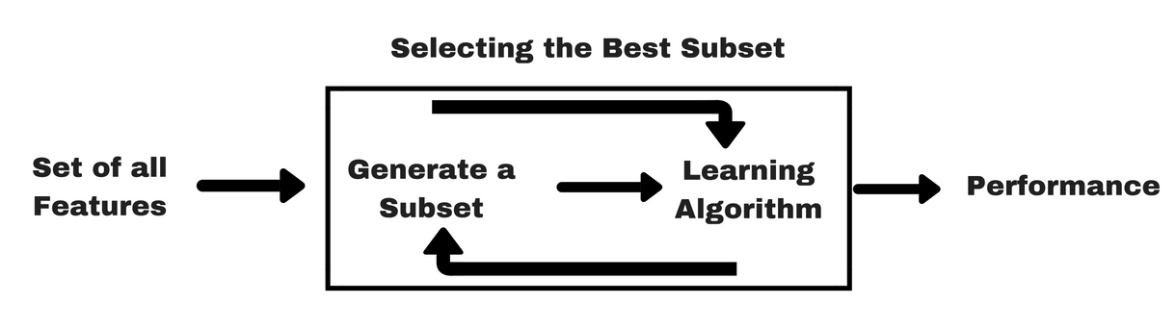
Feature Selection Methods
- Wrapper Method
In wrapper methods, we try to use a subset of features and train a model using them. Based on the inferences that we draw from the previous model, we decide to add or remove features from your subset. The problem is essentially reduced to a search problem. These methods are usually computationally very expensive.
Some common examples of wrapper methods are –
forward feature selection,
backward feature elimination,
recursive feature elimination, etc..

Slide 57
Wrapper Methods 1/
Forward Selection: Forward selection is an iterative method in which we start with having no feature in the model. In each iteration, we keep adding the feature which best improves our model till an addition of a new variable does not improve the performance of the model.
Backward Elimination: In backward elimination, we start with all the features and removes the least significant feature at each iteration which improves the performance of the model. We repeat this until no improvement is observed on removal of features.
Recursive Feature elimination: It is a greedy optimization algorithm which aims to find the best performing feature subset. It repeatedly creates models and keeps aside the best or the worst performing feature at each iteration. It constructs the next model with the left features until all the features are exhausted. It then ranks the features based on the order of their elimination

Slide 58
Wrapper Methods 2/
One of the best ways for implementing feature selection with wrapper methods is to use Boruta package that finds the importance of a feature by creating shadow features.It works in the following steps:
Firstly, it adds randomness to the given data set by creating shuffled copies of all features (which are called shadow features).
Then, it trains a random forest classifier on the extended data set and applies a feature importance measure (the default is Mean Decrease Accuracy) to evaluate the importance of each feature where higher means more important.
At every iteration, it checks whether a real feature has a higher importance than the best of its shadow features (i.e. whether the feature has a higher Z-score than the maximum Z-score of its shadow features) and constantly removes features which are deemed highly unimportant.
Finally, the algorithm stops either when all features get confirmed or rejected or it reaches a specified limit of random forest runs.
For more information on the implementation of Boruta package, you can refer to this article . For the implementation of Boruta in python, refer can refer to this article.

Slide 59
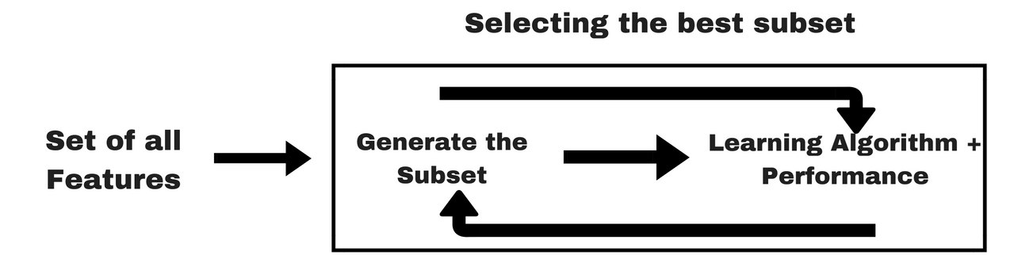
Feature Selection Methods - Embedded methods (Regression)
Embedded methods combine the qualities’ of filter and wrapper methods. It’s implemented by algorithms that have their own built-in feature selection methods.
Some of the most popular examples of these methods are LASSO and RIDGE regression which have inbuilt penalization functions to reduce overfitting.
Lasso regression performs L1 regularization which adds penalty equivalent to absolute value of the magnitude of coefficients.
Ridge regression performs L2 regularization which adds penalty equivalent to square of the magnitude of coefficients.
For more details and implementation of LASSO and RIDGE regression, you can refer to this article.
Other examples of embedded methods are Regularized trees, Memetic algorithm, Random multinomial logit.

Slide 60
Embedded methods -Classification
Bagging
Boosting
Ensemble techniques
Refer- Extra Reading slides

Slide 61
Extra Reading- Difference between Covariance and Correlation
https://towardsdatascience.com/let-us-understand-the-correlation-matrix-and-covariance-matrix-d42e6b643c22#:~:text=In%20simple%20words%2C%20both%20the,linear%20relationship%20between%20two%20variables.
In simple words, both the terms measure the relationship and the dependency between two variables.
“Covariance” indicates the direction of the linear relationship between variables.
“Correlation” on the other hand measures both the strength and direction of the linear relationship between two variables. Correlation is a function of the covariance.
What sets them apart is the fact that correlation values are standardized whereas, covariance values are not.
You can obtain the correlation coefficient of two variables by dividing the covariance of these variables by the product of the standard deviations of the same values. If we revisit the definition of Standard Deviation, it essentially measures the absolute variability of a datasets’ distribution. When you divide the covariance values by the standard deviation, it essentially scales the value down to a limited range of -1 to +1. This is precisely the range of the correlation values.

Slide 62
Extra Study - Heuristic Search in Attribute Selection
There are 2^{d} possible attribute combinations of d attributes
Typical heuristic attribute selection methods:
Best single attribute under the attribute independence assumption: choose by significance tests
Best step-wise feature selection:
The best single-attribute is picked first
Then next best attribute condition to the first, ...
Step-wise attribute elimination:
Repeatedly eliminate the worst attribute
Best combined attribute selection and elimination
Optimal branch and bound:
Use attribute elimination and backtracking

Slide 63
Extra Reading
Decision Trees, RandomForest, Bagging, Boosting etc.

Slide 64
CASE STUDY
FE CASE STUDY
MOBILE PRICING PREDICTION

Slide 65
Text Pre-processing
Source Courtesy: Some of the contents of this PPT are sourced from materials provided by publishers of prescribed books

Slide 66
Step 1 : Data Preprocessing
TEXTUAL DATA PRE PROCESSING
Tokenization — convert sentences to words
Removing unnecessary punctuation, tags
Removing stop words — frequent words such as ”the”, ”is”, etc. that do not have specific semantic
Stemming — words are reduced to a root by removing inflection through dropping unnecessary characters, usually a suffix.
Lemmatization — Another approach to remove inflection by determining the part of speech and utilizing detailed database of the language.
We can use python to do many text preprocessing operations.
NLTK — The Natural Language ToolKit is one of the best-known and most-used NLP libraries, useful for all sorts of tasks from t tokenization, stemming, tagging, parsing, and beyond
BeautifulSoup — Library for extracting data from HTML and XML documents

Slide 67
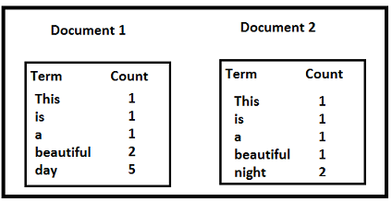
Step 2: Feature Extraction
Bag of Words
The mapping from textual data to real valued vectors is called feature extraction.
Bag of Words (BOW): We make the list of unique words in the text corpus called vocabulary. Then we can represent each sentence or document as a vector with each word represented as 1 for present and 0 for absent from the vocabulary. Another representation can be count the number of times each word appears in a document. The most popular approach is using the Term Frequency-Inverse Document Frequency (TF-IDF) technique.
Term Frequency (TF) = (Number of times term t appears in a document)/(Number of terms in the document)
Inverse Document Frequency (IDF) = log(N/n), where, N is the number of documents and n is the number of documents a term t has appeared in. The IDF of a rare word is high, whereas the IDF of a frequent word is likely to be low. Thus having the effect of highlighting words that are distinct.
We calculate TF-IDF value of a term as = TF * IDF
Let us take an example to calculate TF-IDF of a term in a document.

Slide 68
Step 2: Feature Extraction (cont..)
Bag of Words (cont..)
TF('beautiful',Document1) = 2/10, IDF('beautiful')=log(2/2) = 0 TF(‘day’,Document1) = 5/10, IDF(‘day’)=log(2/1) = 0.30 TF-IDF(‘beautiful’, Document1) = (2/10)*0 = 0 TF-IDF(‘day’, Document1) = (5/10)*0.30 = 0.15
As, you can see for Document1 , TF-IDF method heavily penalizes the word ‘beautiful’ but assigns greater weight to ‘day’. This is due to IDF part, which gives more weightage to the words that are distinct. In other words, ‘day’ is an important word for Document1 from the context of the entire corpus.
One of the major disadvantages of using BOW is that it discards word order thereby ignoring the context and in turn meaning of words in the document.
For natural language processing (NLP) maintaining the context of the words is of utmost importance. To solve this problem we use another approach called Word Embedding.

Slide 69
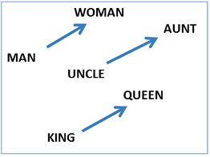
Word Embedding – Word2Vec
Word Embedding
Word Embedding: It is a representation of text where words that have the same meaning have a similar representation. In other words it represents words in a coordinate system where related words, based on a corpus of relationships, are placed closer together.
Word embeddings encode each word into a vector that captures some sort of relation and similarity between words within the text corpus. This means even the variations of words like case, spelling, punctuation, and so on will be automatically learned. In turn, this can mean that some of the text cleaning steps described above may no longer be required.
Word2Vec
Word2vec takes as its input a large corpus of text and produces a vector space with each unique word being assigned a corresponding vector in the space. Word vectors are positioned in the vector space such that words that share common contexts in the corpus are located in close proximity to one another in the space. Word2Vec is very famous at capturing meaning and demonstrating it on tasks like calculating analogy questions of the form a is to b as c is to ?. For example, man is to woman as uncle is to ? (aunt) using a simple vector offset method based on cosine distance.

Slide 70
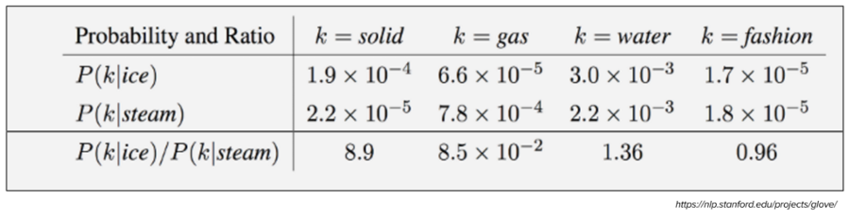
Word Embedding – Glove
Glove
The Global Vectors for Word Representation, or GloVe, algorithm is an extension to the word2vec method for efficiently learning word vectors. GloVe constructs an explicit word-context or word co-occurrence matrix using statistics across the whole text corpus. The result is a learning model that may result in generally better word embedding.
Consider the following example:
Target words: ice, steam Probe words: solid, gas, water, fashion
Let P(k|w) be the probability that the word k appears in the context of word w. Consider a word strongly related to ice, but not to steam, such as solid. P(solid | ice) will be relatively high, and P(solid | steam) will be relatively low. Thus the ratio of P(solid | ice) / P(solid | steam) will be large. If we take a word such as gas that is related to steam but not to ice, the ratio of P(gas | ice) / P(gas | steam) will instead be small. For a word related to both ice and steam, such as water we expect the ratio to be close to one. Refer here for more details.

Slide 71
Step 3: Choosing ML Algorithms
Modelling
There are various approaches to building ML models for various text based applications depending on what is the problem space and data available.
Classical ML approaches like ‘Naive Bayes’ or ‘Support Vector Machines’ for spam filtering has been widely used.
Deep learning techniques are giving better results for NLP problems like sentiment analysis and language translation. Deep learning models are very slow to train and it has been seen that for simple text classification problems classical ML approaches as well give similar results with quicker training time.
References- https://towardsdatascience.com/machine-learning-text-processing-1d5a2d638958
https://towardsdatascience.com/understanding-feature-engineering-part-3-traditional-methods-for-text-data-f6f7d70acd41

Slide 72
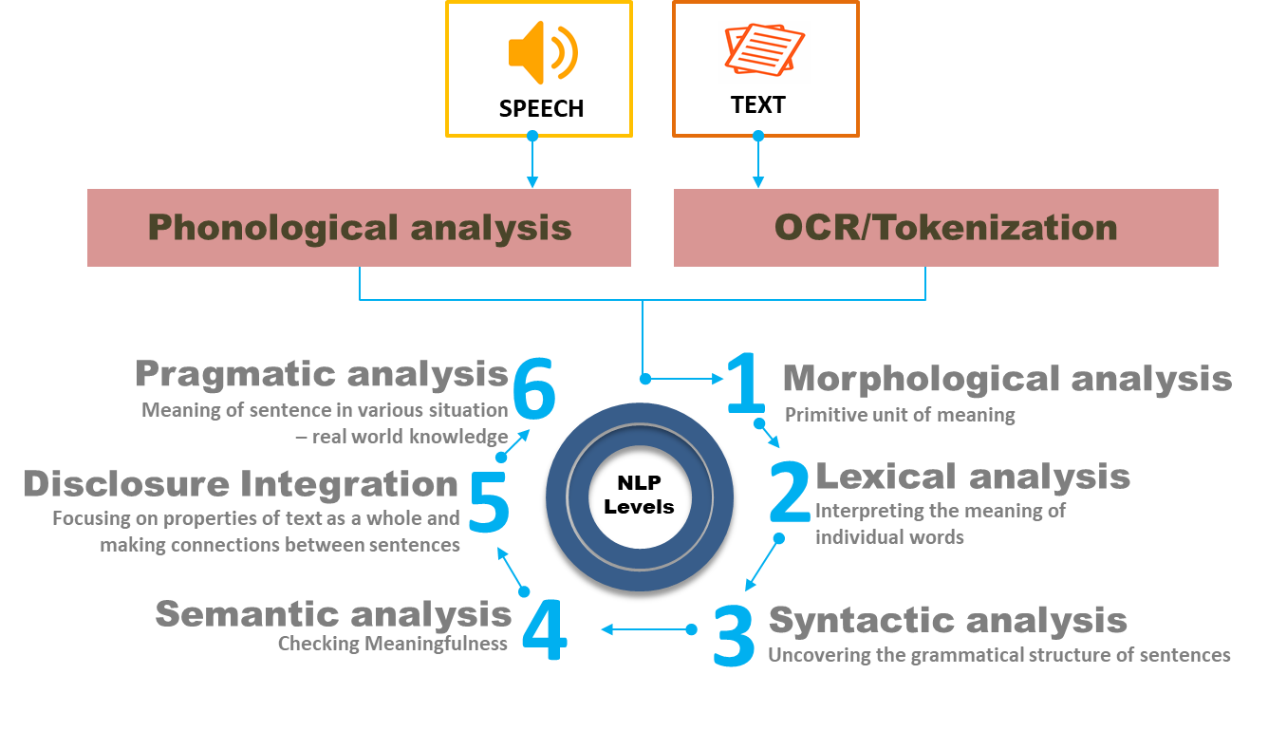
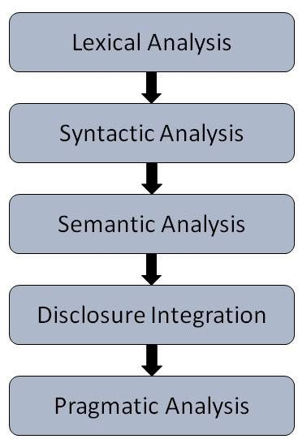
Natural Language Processing – NLP STAGES
NLP STAGES

Slide 73
NLP STAGES contd…
NLP STAGES Explained
Phonological Analysis: This level is applied only if the text origin is a speech. It deals with the interpretation of speech sounds within and across words. Speech sound might give a big hint about the meaning of a word or a sentence. It is study of organizing sound systematically. This requires a broad discussion and is out of scope of our current note.
Tokenization :
Sentence Segmentation
To break the text apart into separate sentences. That gives us this:
“London is the capital and most populous city of England and the United Kingdom.”
“Standing on the River Thames in the south east of the island of Great Britain, London has been a major settlement for two millennia.”
“It was founded by the Romans, who named it Londinium.”
We can assume That each Sentence in English is a separate thought or idea. it will be a lot easier To write a program To understand a single Sentence than To understand a whole paragraph. Coding a Sentence Segmentation model can be as simple as splitting apart sentences whenever you see a punctuation mark. But modern NLP pipelines often use more complex techniques That work even when a document isn’t formatted cleanly.
Word Tokenization
Now that we’ve split our document into sentences, we can process them one at a time. Let’s start with the first sentence from our document:
“London is the capital and most populous city of England and the United Kingdom.”
The next step in our pipeline is to break this sentence into separate words or tokens. This is called tokenization. This is the result:
“London”, “is”, “ the”, “capital”, “and”, “most”, “populous”, “city”, “of”, “England”, “and”, “the”, “United”, “Kingdom”, “.”
Tokenization is easy to do in English. We’ll just split apart words whenever there’s a space between them. And we’ll also treat punctuation marks as separate tokens since punctuation also has meaning.

Slide 74
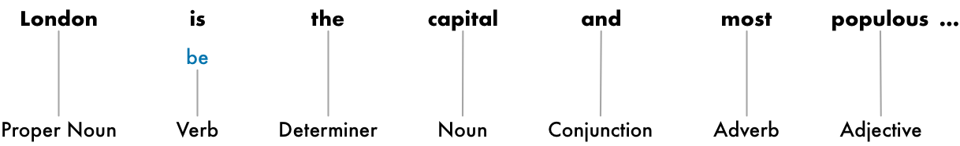
NLP STAGES contd…
MORPHOLOGICAL ANALYSIS
Deals with understanding distinct words according to their morphemes ( the smallest units of meanings) . Taking, for example, the word: “unhappiness ”. It can be broken down into three morphemes (prefix, stem, and suffix), with each conveying some form of meaning: the prefix un- refers to “not being”, while the suffix -ness refers to “a state of being”. The stem happy is considered as a free morpheme since it is a “word” in its own right. Bound morphemes (prefixes and suffixes) require a free morpheme to which it can be attached to, and can therefore not appear as a “word” on their own.
Stemming: Stemming is a rudimentary rule-based process of stripping the suffixes (“ing”, “ly”, “es”, “s” etc) from a word.
Text Lemmatization: Lemmatization, on the other hand, is an organized & step by step procedure of obtaining the root form of the word, it makes use of vocabulary (dictionary importance of words) and morphological analysis (word structure and grammar relations).
In NLP, we call finding this process lemmatization — figuring out the most basic form or lemma of each word in the sentence.
a) Both sentences talk about the noun pony, but they are using different inflections. When working with text in a computer, it is helpful to know the base form of each word so that you know that both sentences are talking about the same concept. Otherwise the strings “pony” and “ponies” look like two totally different words to a computer.
b) The same thing applies to verbs. We can also lemmatize verbs by finding their root, unconjugated form. So “I had two ponies” becomes “I [have] two [pony].”

Slide 75
NLP STAGES contd..
LEXICAL ANALYSIS
It involves identifying and analyzing the structure of words. Lexicon of a language means the collection of words and phrases in a language. Lexical analysis is dividing the whole chunk of txt into paragraphs, sentences, and words. Here focus is to find individual meaning of words.
SYNTACTIC ANALYSIS
It involves analysis of words in the sentence for grammar and arranging words in a manner that shows the relationship among the words. The sentence such as “The school goes to boy” is rejected by English syntactic analyzer.
Deals with analyzing the words of a sentence so as to uncover the grammatical structure of the sentence. E.g.. "Colourless green idea." This would be rejected by the Symantec analysis as colorless here; green doesn't make any sense.
Syntactical parsing involves the analysis of words in the sentence for grammar and their arrangement in a manner that shows the relationships among the words. Dependency Grammar and Part of Speech tags are the important attributes of text syntactics.
PREDICTING PARTS of SPEECH
The goal is to build a tree that assigns a single parent word to each word in the sentence. The root of the tree will be the main verb in the sentence. Here’s what the beginning of the parse tree will look like for our sentence:
But we can go one step further. In addition to identifying the parent word of each word, we can also predict the type of relationship that exists between those two words:
This parse tree shows us that the subject of the sentence is the noun “London” and it has a “be” relationship with “capital”. We finally know something useful — London is a capital! And if we followed the complete parse tree for the sentence (beyond what is shown), we would even found out that London is the capital of the United Kingdom.

Slide 76
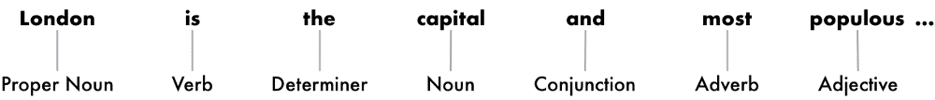
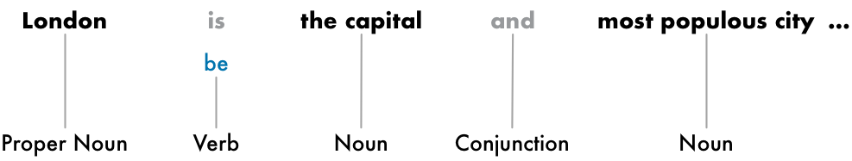
NLP STAGES contd..
SYNTACTIC ANALYSIS contd…
Predicting Parts of Speech for Each Token
Next, we’ll look at each token and try to guess its part of speech — whether it is a noun, a verb, an adjective and so on. Knowing the role of each word in the sentence will help us start to figure out what the sentence is talking about.
We can do this by feeding each word (and some extra words around it for context) into a pre-trained part-of-speech classification model:
Finding Noun Phrases
So far, we’ve treated every word in our sentence as a separate entity. But sometimes it makes more sense to group together the words that represent a single idea or thing. We can use the information from the dependency parse tree to automatically group together words that are all talking about the same thing. We can group the noun phrases to generate this:

Slide 77
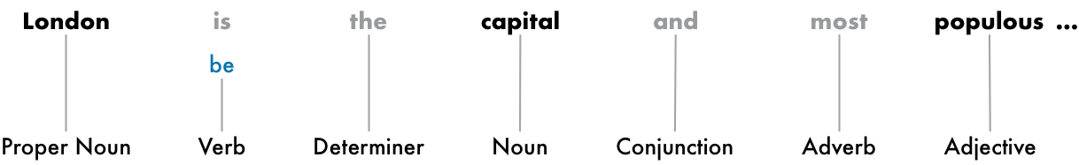
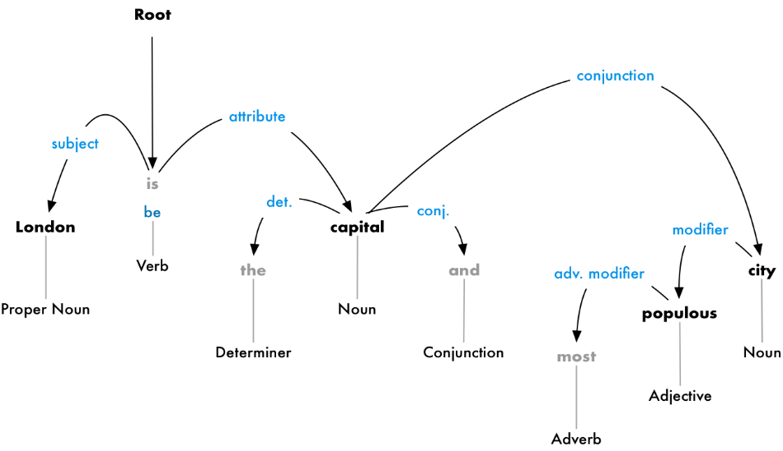
NLP STAGES contd…
SYNTACTIC ANALYSIS contd…
Identifying Stop Words
English has a lot of filler words that appear very frequently like “and”, “the”, and “a”. When doing statistics on text, these words introduce a lot of noise since they appear way more frequently than other words. Some NLP pipelines will flag them as stop words —that is, words that you might want to filter out before doing any statistical analysis.
Here’s how our sentence looks with the stop words grayed out:
Stop words are usually identified by just by checking a hardcoded list of known stop words. But there’s no standard list of stop words that is appropriate for all applications. The list of words to ignore can vary depending on your application.

Slide 78

NLP STAGES contd…
SEMANTIC ANALYSIS
It draws the exact meaning or the dictionary meaning from the text. The text is checked for meaningfulness. It is done by mapping syntactic structures and objects in the task domain. The semantic analyzer disregards sentence such as “hot ice-cream”.
To figure out how all the words in our sentence relate to each other. This is also called dependency parsing.
Named Entity Recognition (NER)
The goal of Named Entity Recognition, or NER, is to detect and label these nouns with the real-world concepts that they represent. Here’s what our sentence looks like after running each token through our NER tagging model:
But NER systems aren’t just doing a simple dictionary lookup. Instead, they are using the context of how a word appears in the sentence and a statistical model to guess which type of noun a word represents. A good NER system can tell the difference between “Brooklyn Decker” the person and the place “Brooklyn” using context clues.

Slide 79
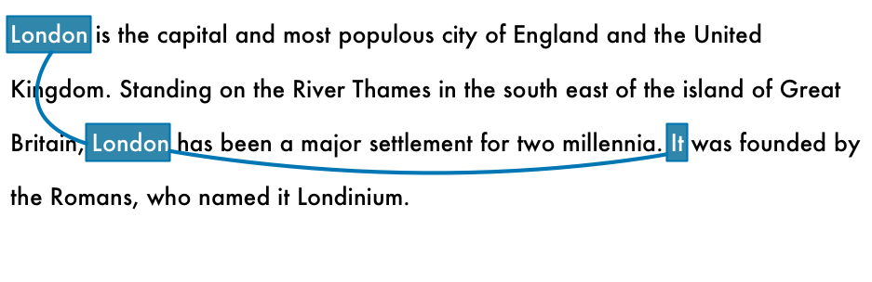
NLP STAGES contd…
DISCOURSE INTEGRATION
The meaning of any sentence depends upon the meaning of the sentence just before it. In addition, it also brings about the meaning of immediately succeeding sentence.
English is full of pronouns — words like he, she, and it. These are shortcuts that we use instead of writing out names over and over in each sentence. Humans can keep track of what these words represent based on context. But our NLP model doesn’t know what pronouns mean because it only examines one sentence at a time.
“It was founded by the Romans, who named it Londinium.”
If we parse this with our NLP pipeline, we’ll know that “it” was founded by Romans. But it’s a lot more useful to know that “London” was founded by Romans.
As a human reading this sentence, you can easily figure out that “it” means “London”. The goal of coreference resolution is to figure out this same mapping by tracking pronouns across sentences. We want to figure out all the words that are referring to the same entity.
Here’s the result of running coreference resolution on our document for the word “London”:

Slide 80
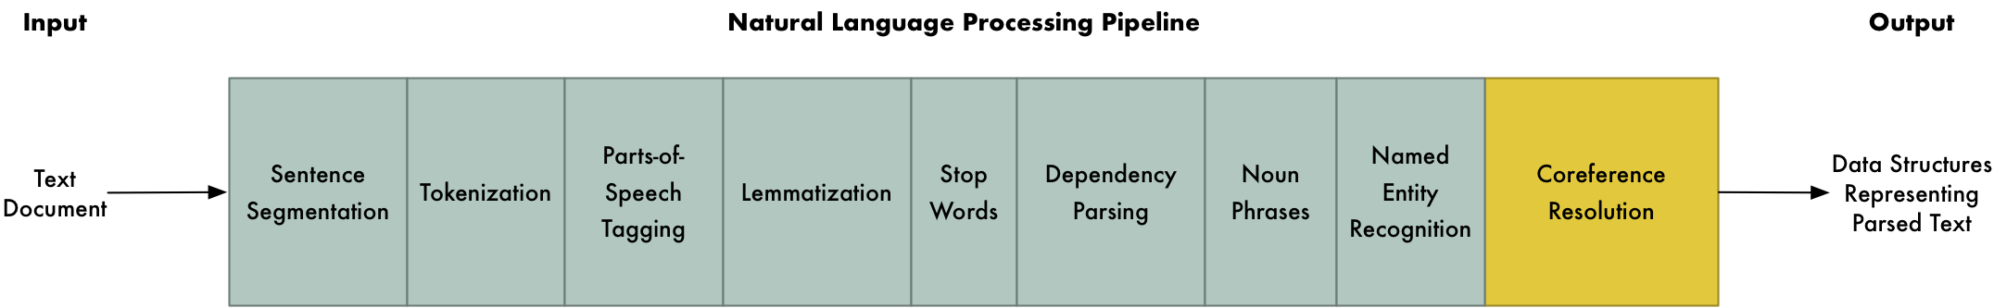
NLP PIPELINE
Text Pre-processing Libraries | Coreference Resolution
SPACY | NeuralCoref
CORENLP | StanfordNLP
NLTK | BERT
GENSIM | AllenNLP
PyNLPI | Google AutoML
 | IBMWatson
 | HuggingFace
 | Berkley Neural Parser
https://towardsdatascience.com/the-best-nlp-tools-of-early-2020-live-demos-b6f507b17b0a
https://towardsdatascience.com/coreference-resolution-in-python-aca946541dec
https://towardsdatascience.com/python-libraries-for-natural-language-processing-be0e5a35dd64

Slide 81
TEXT ANALYTICS CASE STUDY
FEATURE EXTRACTION FROM TEXTUAL DATA
STACK OVERFLOW DATA – feature extraction

Slide 82
Prescribed Text Books
 | Author(s), Title, Edition, Publishing House
T1 | Tan P. N., Steinbach M & Kumar V. “Introduction to Data Mining” Pearson Education
T2 | Data Mining: Concepts and Techniques, Third Edition by Jiawei Han, Micheline Kamber and Jian Pei Morgan Kaufmann Publishers
https://www.tutorialspoint.com/artificial_intelligence/artificial_intelligence_natural_language_processing.htm
https://datascience.foundation/sciencewhitepaper/natural-language-processing-nlp-simplified-a-step-by-step-guide
https://medium.com/@ageitgey/natural-language-processing-is-fun-9a0bff37854e

Slide 83
Prescribed Text Books
 | Author(s), Title, Edition, Publishing House
T1 | Tan P. N., Steinbach M & Kumar V. “Introduction to Data Mining” Pearson Education
T2 | Data Mining: Concepts and Techniques, Third Edition by Jiawei Han, Micheline Kamber and Jian Pei Morgan Kaufmann Publishers

Slide 84
References
https://unstats.un.org/unsd/dnss/docs-nqaf/UK-Guidelines_Subject.pdf
https://www.folkstalk.com/2010/01/types-of-dimensions.html?m=1
https://www.folkstalk.com/2010/01/data-warehouse-dimensional-modelling.html
https://www.metrology-journal.org/articles/ijmqe/full_html/2017/01/ijmqe160046/ijmqe160046.html

Slide 85
Appendix
More In-depth Reading

Slide 86
Techniques of Feature Engineering
3 categories -
1:1 Transformations - Engineering techniques are those that address problematic characteristics of individual predictors
1:Many Transformations - Methods for expanding individual predictors into many predictors in order to better represent more complex predictor-response relationships
Many : Many Transformations -Methodology for consolidating redundant information across many predictors

Slide 87
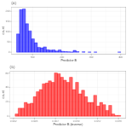
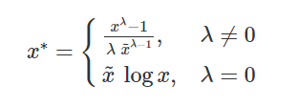
1:1 Transformations 1/
Box-cox transformation
uses maximum likelihood estimation to estimate a transformation parameter λ in the equation, derived based on data
~x is the geometric mean of the predictor data.
Because the parameter of interest is in the exponent, this type of transformation is called a power transformation.
Some values of λ map to common transformations, such as λ=1 (no transformation), λ=0 (log), λ=0.5 (square root), and λ=−1 (inverse).
It is important to note that the Box-Cox procedure can only be applied to data that is strictly positive.
For the data in Figure 6.1, the parameter was estimated from the training set data to be ˆλ=−1.09λ^=−1.09. This is effectively the inverse transformation. Figure 6.1(b) shows the results when the transformation is applied to the test set, and yields a transformed distribution that is approximately symmetric.

Slide 88
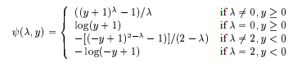
1:1 Transformations 2/
2. Yeo and Johnson Transformation
Overcomes the shortcoming of Box and com that it could be applied to data that is strictly positive.
https://www.stat.umn.edu/arc/yjpower.pdf

Slide 89
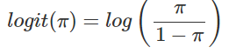
1:1 Transformations 3/
3. Logit Transformation
Another important transformation to an individual variable is for a variable that has values bounded between zero and one, such as proportions.
The problem with modeling this type of outcome is that model predictions might may not be guaranteed to be within the same boundaries. For data between zero and one, the logit transformation could be used. If π is the variable, the logit transformations is:
This transformation changes the scale from values between zero and one to values between negative and positive infinity. On the extremes, when the data are absolute zero or one, a small constant can be added or subtracted to avoid division by zero. Once model predictions are created, the inverse logit transformation can be used to place the values back on their original scale.
4. Arcsine transformation
An alternative to the logit transformation is the arcsine transformation. This is primarily used on the square root of the proportions
y∗=arcsine(√π)y∗=arcsine(π).

Slide 90
1:1 Transformations – Scaling Techniques 4/
5. Centering
The predictor’s training set average is subtracted from the predictor’s individual values. When this is applied separately to each variable, the collection of variables would have a common mean value (i.e., zero).
X* = X – X_{mean}
6. Scaling
Scaling is the process of dividing a variable by the corresponding training set’s standard deviation. This ensures that that variables have a standard deviation of one.
X* = X/SD

Slide 91
1:1 Transformations – Scaling Techniques 5/
7. Range Scaling
Range scaling uses the training set minimum and maximum values to translate the data to be between an arbitrary range (usually zero and one).
Again, it is emphasized that the statistics required for the transformation (e.g., the mean) are estimated from the training set and are applied to all data sets (e.g., the test set or new samples).
NOTE- Scaling transformations are mostly innocuous and are typically needed when the model requires the predictors to be in common units. For example, when the distance or dot products between predictors are used (such as K-nearest neighbors or support vector machines) or when the variables are required to be a common scale in order to apply a penalty (e.g., the lasso or ridge regression), a standardization procedure is essential.

Slide 92
1:1 Transformations – Data Smoothing 6/
Another helpful preprocessing methodology that can be used on data containing a time or sequence effect is simple data smoothing. For example, a running mean can be used to reduce excess noise in the predictor or outcome data prior to modeling.
For example, a running 5-point mean would replace each data point with the average of itself and the two data points before and after its position
As one might expect, the size of the moving window is important; too large and the smoothing effect can eliminate important trends, such as nonlinear patterns.
A short running median can also be helpful, especially if there are significant outliers. When an outlier falls into a moving window, the mean value is pulled towards the outlier. The median would be very insensitive to an aberrant value and is a better choice. It also has the effect of changing fewer of the original data points.

Slide 93
1:1 Transformations – Data Smoothing 7/
NOTE-
It is important to make sure that the test set predictor data are smoothed separately to avoid having the training set influence values in the test set (or new unknown samples).
Smoothing predictor data to reduce noise

Slide 94
Log Transform – Data Smoothing
Calculating the logarithmic value. A critical note: The data you apply log transform must have only positive values, otherwise you receive an error. Also, you can add 1 to your data before transform it. Thus, you ensure the output of the transformation to be positive.
Log(x+1)
Benefits of log transform:
It helps to handle skewed data and after transformation, the distribution becomes more approximate to normal.
In most of the cases the magnitude order of the data changes within the range of the data. For instance, the difference between ages 15 and 20 is not equal to the ages 65 and 70. In terms of years, yes, they are identical, but for all other aspects, 5 years of difference in young ages mean a higher magnitude difference. This type of data comes from a multiplicative process and log transform normalizes the magnitude differences like that.
It also decreases the effect of the outliers, due to the normalization of magnitude differences and the model become more robust.

Slide 95
Extracting Dates 1/
Building an ordinal relationship between the values is very challenging for a machine learning algorithm if you leave the date columns without manipulation. Here, I suggest three types of preprocessing for dates:
Extracting the parts of the date into different columns: Year, month, day, etc.
Extracting the time period between the current date and columns in terms of years, months, days, etc.
Extracting some specific features from the date: Name of the weekday, Weekend or not, holiday or not, etc.

Slide 96
Extracting Dates 2/
from datetime import date data = pd.DataFrame({'date': ['01-01-2017', '04-12-2008', '23-06-1988', '25-08-1999', '20-02-1993', ]}) #Transform string to date data['date'] = pd.to_datetime(data.date, format="%d-%m-%Y") #Extracting Year data['year'] = data['date'].dt.year #Extracting Month data['month'] = data['date'].dt.month #Extracting passed years since the date data['passed_years'] = date.today().year - data['date'].dt.year #Extracting passed months since the date data['passed_months'] = (date.today().year - data['date'].dt.year) * 12 + date.today().month - data['date'].dt.month #Extracting the weekday name of the date data['day_name'] = data['date'].dt.day_name()
date year month passed_years passed_months day_name 0 2017-01-01 2017 1 2 26 Sunday 1 2008-12-04 2008 12 11 123 Thursday 2 1988-06-23 1988 6 31 369 Thursday 3 1999-08-25 1999 8 20 235 Wednesday 4 1993-02-20 1993 2 26 313 Saturday

Slide 97
Grouping Operations
Numerical Column Grouping
Numerical columns are grouped using sum and mean functions in most of the cases. Both can be preferable according to the meaning of the feature. For example, if you want to obtain ratio columns, you can use the average of binary columns.

Slide 98
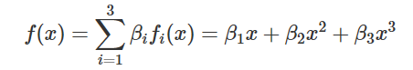
1:Many Transformation : Non-Linear Features 1/
Transformations can be made on a single numeric predictor to expand it to many predictors. These one-to-many transformations of the data can be used to improve model performance.
Nonlinear Features via Basis Expansions and Splines
https://en.wikipedia.org/wiki/Smoothing_spline
Cubic spline definition
A basis expansion of a predictor x can be achieved by deriving a set of functions fi(x) that can be combined using a linear combination. For a continuous predictor x, a cubic basis expansion is –
The β values could be estimated using basic linear regression.
2. De Boor's approach
3. Multidimensional splines

Slide 99
Many : Many Transformations
When creating new features from multiple predictors, there is a possibility of correcting a variety of issues such as outliers or collinearity.
Dimensionality Reduction techniques are all of this category
Linear Projection Matrix
Techniques create meaningful projections of the given set of predictors
Creation of a similarity matrix from the given set of predictors;
Finding Eigen Values and Eigen Vectors from Similarity Matrix
Specific techniques discussed here are
principal components analysis (PCA), kernel PCA,
independent component analysis (ICA),
non-negative matrix factorization (NNMF), and
partial least squares (PLS)
Un-supervised Techniques

Slide 100
Linear Projection Matrix contd..
These methods are linear in the sense that they take a matrix of numeric predictor values (X) and create new components that are linear combinations of the original data. These components are usually called the scores. If there are n training set points and p predictors, the scores could be denoted as the n×p matrix X* and are created using -
X∗ = XA
where the p×p matrix A is often called the projection matrix. As a result, the value of the first score for data point i would be:
x∗_{i1} = a₁₁x_{i1} + a₁₂x_{i2} + a₁₃x_{i3} + a₁₄x_{i4 .....} + a_{1p}x_{ip}
One possibility is to only use a portion of AA to reduce the number of scores down to k<pk. For example, it may be that the last few columns of A show no benefit to describing the predictor set. This notion is called dimension reduction i.e. If the predictor space can be described with k score variables, there are less features in the data given to the model but each of these columns is a function of all of the original predictors.

Slide 101
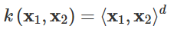
Kernel PCA
PCA is an effective dimension reduction technique when predictors are linearly correlated and when the resulting scores are associated with the response. However, the orthogonal partitioning of the predictor space may not provide a good predictive relationship with the response, especially if the true underlying relationship between the predictors and the response is non-linear. Consider, for example, a hypothetical relationship between a response (y) and two predictors (x1 and x2) as follows:
The kernel PCA approach combines a specific mathematical view of PCA with kernel functions and the kernel ‘trick’ to enable PCA to expand the dimension of the predictor space in which dimension reduction is performed.
PCA -> Eigen Values decomposition can be written as Dot Product of 2 predictors x1 and x2. Known as Linear kernel
In Kernel PCA -> instead of linear kernel, using Trick function, it can be -

Slide 102
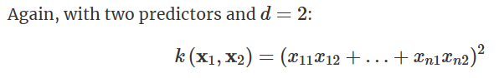
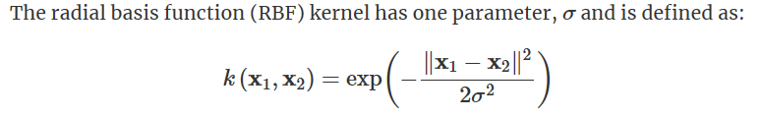
Kernel PCA contd..
The RBF kernel is also known as the Gaussian kernel due to its mathematical form and its relationship to the normal distribution. The radial basis and polynomial kernels are popular starting points for kernel PCA.

Slide 103
Independent Component Analysis - ICA
ICA creates new components that are linear combinations of the original variables but does so in a way that the components are as statistically independent from one another as possible.
This enables ICA to be able to model a broader set of trends than PCA, which focuses on orthogonality and linear relationships.
It is common to normalize and whiten the data prior to running the ICA calculations.
Whitening, in this case, means to convert the original values to the full set of PCA components.
https://www.youtube.com/watch?v=P5mnh_xOSAA

Slide 104
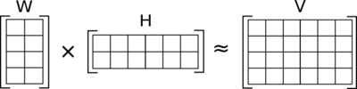
Non-negative Matrix Factorization
https://www.youtube.com/watch?v=UQGEB3Q5-fQ
Non-negative matrix factorization (NMF or NNMF), also non-negative matrix approximation^{[1][2]} is a group of algorithms in multivariate analysis and linear algebra where a matrix V is factorized into (usually) two matrices W and H, with the property that all three matrices have no negative elements.
This approach is popular for text data where predictors are word counts, imaging, and biological measures (e.g., the amount of RNA expressed for a specific gene).

Slide 105
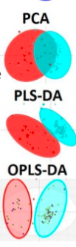
Partial Least Squares
Partial least squares regression (PLS regression) is a statistical method that bears some relation to principal components regression; instead of finding hyperplanes of maximum variance between the response and independent variables, it finds a linear regression model by projecting the predicted variables and the observable variables to a new space.
Because both the X and Y data are projected to new spaces, the PLS family of methods are known as bilinear factor models. Partial least squares discriminant analysis (PLS-DA) is a variant used when the Y is categorical.
https://www.slideshare.net/dgrapov/4-partial-least-squares-modeling

